Slide 1
Hashing: Implementation Issues
EECS 233

Slide 2
Recap
Hash functions desiderata
Handling collisions with separate chaining
Handling collisions with open addressing
  Linear probing
  Quadratic probing
  Double hashing
  Need to distinguish between “removed” and “empty” positions

Slide 3
Implementation of Hash Tables
A simple hash table with open addressing.
  public class HashTable {
    private class Entry {
      private String key;
      private String etymology;
      private boolean removed;
    }
    private Entry[] table;
    private int tableSize;
    ...
  }
for an empty position, table[i] will equal null
for a removed position, table[i] will refer to an Entry object whose removed field equals true
for an occupied position, table[i] will refer to an Entry object whose removed field equals false
open (“unoccupied”, “available”) position is either empty or removed

Slide 4
Constructors
  public class HashTable {
    private class Entry {
      private String key;
      private String etymology;
      private boolean removed;
    }
    private Entry[] table;
    private int tableSize;
    ...
  }
Initializing the hash table
  public HashTable(int size) {
    table = new Entry[size];
    tableSize = size;
  }
Initializing an entry (before insertion)
  private Entry(String key, String etymology) {
    this.key = key;
    this.etymology = etymology;
    removed = false;
  }

Slide 5
Finding An Open Position
Using double hashing
  private int probe(String key) {
    int i = h1(key); // first hash function
    int j = h2(key); // second hash function
    // keep probing while the current position is occupied (non-empty and non-removed)
    while ( ? )
      ?
    return i;
  }
Does it always terminate?
table[i] != null && table[i].removed==false
    i = (i + j) % tableSize;

Slide 6
Finding An Open Position: Infinite Loops
The loop in our probe method could become infinite.
To avoid infinite loops, we can stop probing after checking n positions (n = table size) because the probe sequence will just repeat after that point.
  for double hashing:
    (h1 + n*h2) % n = h1 % n
    (h1 + (n+1)*h2) % n = (h1 + n*h2 + h2) % n = (h1 + h2)%n
    (h1 + (n+2)*h2) % n = (h1 + n*h2 + 2*h2) % n = (h1 + 2*h2)%n
    …
  for quadratic probing:
    (h1 + n²) % n = h1 % n
    (h1 + (n+1)²) % n = (h1 + n² + 2n + 1) % n = (h1 + 1)%n
    (h1 + (n+2)²) % n = (h1 + n² + 4n + 4) % n = (h1 + 4)%n
    …

Slide 7
Finding An Open Position: Infinite Loop Protection
  private int probe(String key) {
    int i = h1(key); // first hash function
    int j = h2(key); // second hash function
    int iterations = 0;
    // keep probing until we get an empty or removed position
    while (table[i] != null && table[i].removed==false) {
      i = (i + j) % tableSize;
      iterations++;
      if (iterations > tableSize) return -1;
    }
    return i;
  }

Slide 8
Finding the Position of A Key
Different from probe()
  Returns position of the key, not an available position.
  private int findKey(String key) {
    int i = h1(key); // first hash function
    int j = h2(key); // second hash function
    int iterations = 0;
    // keep probing while the entry is not empty
    while ( ? ) {
      // return if key is found, otherwise continue
      ?
      i = (i + j) % tableSize;
      iterations++;
      if (iterations > tableSize) return -1;
    }
    return -1;
  }
table[i] != null
if (table[i].key == key)
return i;
if (table[i].removed==false && table[i].key.equals(key))
return i;

Slide 9
Search() Method
Search for the entry with the key, and return the associated data (string etymology in our example)
  public String search(String key) {
    int i = findKey(key);
    if (i == -1)
      return null;
    else
      return table[i].etymology ;
  }
It calls the helper method findKey() to locate the position of the key.

Slide 10
Remove() Method
Search the hash table and delete the key if found
  public void remove(String key) {
    int i = findKey(key);
    if (i == -1)
      return;
    table[i].removed = true;
  }
It also uses findKey().

Slide 11
Insertion
We begin by probing for the key to find an empty position.
Two cases:
  Encountered an open (empty or removed) position while probing
    put the (key, value) pair in the open position
  No removed or empty position encountered
    Overflow: throw an exception

Slide 12
Insert() Method
If no empty or removed position is available, report error; otherwise, insert the new entry
  public void insert(String key, String etymology) {
    int i = probe(key);
    if (i == -1)
      throw new RuntimeException(“HashTable full”);
    else
      ?
  }

Slide 13
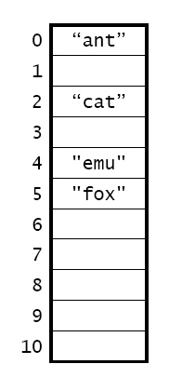
Tracing the Methods
Start with the hash table at right with:
  double hashing
  our earlier hash functions h1 and h2
    h1: <first character> -’a’
    h2: length
Perform the following operations:
  insert "bear"
  insert "bison"
  insert "cow"
  remove "emu"
  search "eel"
  insert "bee"
bear
______
bee
bison
cow

Slide 14
Issues and Questions
As the hash table is used, more positions will be marked removed
  How does this affect running time?
    Insertion?
    Search? (Successful/unsuccessful)?
    Deletion?
If the hash table gets almost full, how does this affect running time?
  Insertion?
  Search?
  Deletion?

Slide 15
Hash Table Performance May Degrade
When many entries are “removed”, search must continue
  If the searched key is in the table, it is likely it will be found after a few iterations
  However, if the key is not in the table at all, search continues until reaching an “empty” entry, or after N iterations
When most entries are occupied, insertion method may not be able to find an open position quickly
  the load factor λ of a hash table is the ratio of the number of keys to the table size.
  The expected number of iterations obviously grows with λ

Slide 16
Rehashing
What to do in the first case?
  Here the load factor is not high at all, but that many entries are not utilized (marked as “removed”).
    the load factor can be easily tracked.
  “Rehash” the entries: Create another hash table, and move every entry to the new table
What to do in the second case?
  Here the problem is high load factor
  Expand the hash table: create a new hash table of roughly doubled size, and move the entries to the new table
What is the running time of rehashing? Does it affect the overall running of hash table operations?
  May not happen very often, e.g., once every O(N) insertions
  But when it happens, may take some running time

Slide 17
Rehash() Method (Expanding)
  public class HashTable {
    private class Entry {
      private String key;
      private String etymology;
      private boolean removed;
    }
    private Entry[] table;
    private int tableSize;
    ...
  }
Let us still consider the example hash table:
    public void rehash( ) {
      int oldSize = tableSize;
      Entry[ ] oldTable = table;
      tableSize = nextPrime(2 * oldSize);
      table = new Entry[tableSize];
      for(i = 0; i < oldSize; i++)
        if ( ? )
        ?
    }
We define rehash() as public so the user can decide when to rehash

Slide 18
Efficiency of Hash Tables
In the best case, search and insertion are O(1).
In the worst case, search and insertion are linear.
  open addressing: O(m), where m = the size of the hash table
  separate chaining: O(n), where n = the number of keys
With a good choice of hash function and table size, the time complexity is generally better than O(log n) and approaches O(1).
As the load factor increases, performance tends to decrease.
  Open addressing: try to keep the load factor < ½
  Separate chaining: try to keep the load factor < 1
Time-space tradeoff: bigger tables tend to have better performance, but they use up more memory.

Slide 19
Limitations of Hash Tables
It can be hard to come up with a good hash function for a particular data set.
  The choice of hash functions may depend on the characteristics of the data set.
  Complexity of hash functions
The items are not ordered by key. As a result, we can’t easily
  Print the contents in sorted order
  Solve the selection problem - get the k-th largest item
We can do all of these things with many tree structures.

Slide 20
Implementation of Hash Function

Slide 21
Hash Functions Desiderata Revisited
Example: String as key (e.g., Webster)
  keys = character strings composed of lower-case letters
  hash function:
    h(key) = (the byte sum of all characters) mode table-size
    example: h(“cat”) = (‘a’ + ‘c’ + ‘t’) mod 100000
    But: assume words are mostly up to 20 character-long
      Max sum is 127*20 = 2540; any larger table is of no use!
    But: permutations are not distinguished
      h(“cat”) = h(“act”)
Requirements for good hash functions:
  Full table size utilization
  Even (“uniform”) key mapping throughout the table
    Utilizing known key distribution in the objects
    Making hash function “random” - the distribution of keys is independent of distribution of indexes to which they map
Using the entire key to compute the hash value
Must be efficient to compute!

Slide 22
Hash Functions for Strings
Bad example: the sum of the character codes
A better example: a weighted sum of the character codes
  h_{b} = (a₀b^{n–1} + a₁b^{n–2} + … + a_{n–2}b¹ + a_{n–1}) mod (tableSize)
    a_{i} is encoding of the i-th character,
    b is a constant
  All characters contribute
  Contribution of a character depends on its position
Examples for b = 31:
  h_{b}(“table”) = 116*31⁴ + 97*31³ + 98*31² + 108*31 + 101 = 110115790
  h_{b}(“eat”) = 101*31² + 97*31 + 116 = 100184
  h_{b}(“tea”) = 116*31² + 101*31 + 97 = 114704
Java uses this hash function with b = 31 in the hashCode() method of the String class.
What happens if we use a table size of 31?

Slide 23
Hash Functions for Strings
How to calculate h_{b}(supercalifragilisticexpialidocious)?
  ‘s’ b³³ + ‘u’ b³² + … + ‘s’.
  A lot of multiplications!
Better way: Horner’s method
  a₀b^{n–1} + a₁b^{n–2} + … + a_{n–2}b¹ + a_{n–1} = (…((a₀b + a₁)b + a₂)b + … + a_{n–2})b + a_{n–1}
  example: 101*31² + 97*31 + 116 = ((101*31 + 97)*31 + 116
For b=31, we have more efficient ways to “multiply by 31”
  n << i shifts the binary representation of n left by i places
  n << i = n * 2^{i}
  n * 31 = n * (32 – 1) = (n * 32) – n = (n << 5) – n
  example: n = 100 = 0000000001100100₂
    100 << 5 = 0000110010000000₂ = 3200
    100 * 31 = 3200 – 100 = 3100
  int hash = 0;
  for (int i = 0; i < s.length(); i++)
    hash = hash * b + s.charAt(i);

Slide 24
External Hashing?
Recall search trees (binary trees/AVL trees) => B-trees
  Each tree node holds multiple key ranges
What if the hash table is too large to be in main memory?
How about just using disk addresses instead of memory addresses?
  Hash table = hash file
  Slot position = offset in the hash file
  References in separate chaining = file addresses
Issues:
  Worst time access - O(N) random disk accesses
  Hash table reorganization - O(N) random disk accesses

Slide 25
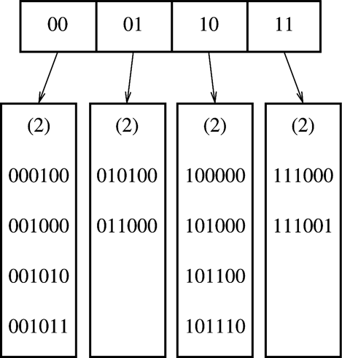
Extendible Hashing
Fagin, R.; Nievergelt, J. & Pippenger, N. et al. (September, 1979), "Extendible Hashing - A Fast Access Method for Dynamic Files", ACM Trans. on Database Systems 4(3)
Choose a hash function with a large range.
Use i senior bits as an offset into a table of bucket addresses.
Store entries in the buckets
  Entries in the same bucket share common prefix in hash values
Search for key K
  Compute h(K)
  Take i senior bits
  Look up the directory entry using i-bit offset
  Follow the bucket pointer

Slide 26
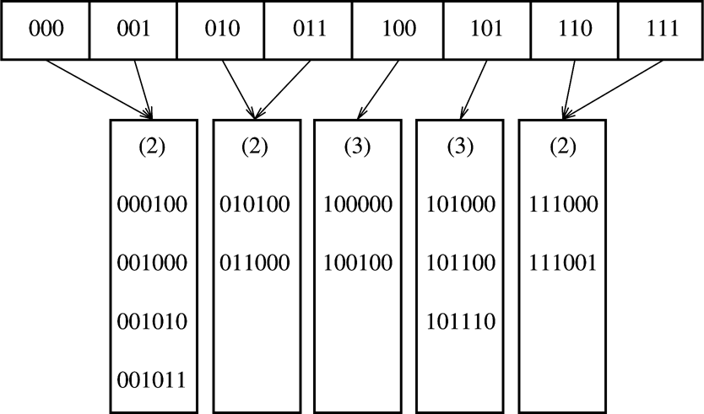
Insertions into Extendible Hash (Case 1)
Insertion of 100100: leaf split and directory split
  Only involves reorg of directory (main memory) and one bucket (localized damage)
Bucket’s common prefix can be shorter than i

Slide 27
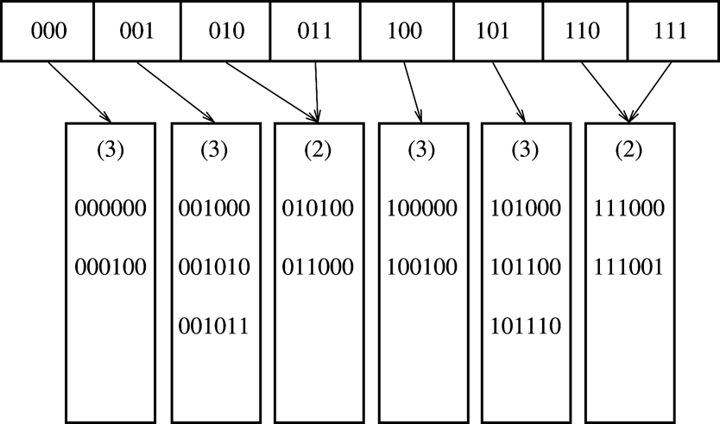
Insertions into Extendible Hash (Case 2)
Adding 000000 - leaf split only

Slide 28
Insertions into Extendible Hash (Case 3)
0000
0001
0010
0011
…
1110
1111
(2)
(2)
(4)
(4)
000100
001000
001010
001011
111000
111001
111010
111011
010100
011000
…
111100
Insert 111010, 111011, 111100
Last bucket to split
Can’t distinguish two new buckets with i+1 bits
  Increase directory offset bits by 2

Slide 29
Deletions from Extendible Hash
Reverse to insertions
Buckets may merge
Directory may be reorganized

Slide 30
Extendible Hash Discussion
B-trees
  B-tree nodes are less space efficient (store key ranges)
  Processing at a node (including root) requires matching a key against key ranges (logarithmic at best)
Extendible hash
  Constant-time directory access
  Directory is space-efficient (just bucket pointers)
  But: directory must fit into memory
Researcher’s questions:
  What if directory does not fit into memory?
  Is this likely to happen?
    If yes, we have a problem to solve!
    If not, when do you ever want to use a B-tree?
      (Assuming you only need operations supported by a hash table)

